Slide 1
Bargaining Update
Pension
September 21, 2018

Slide 2
Pension Bargaining Results
Very productive round of bargaining with respect to the CUPE Employees’ Pension Plan.
A number of very positive changes were achieved:
Improvement to the bridge benefit
Catch-up indexing to be provided to current retirees
Greater assurance of future indexing, including an increase in employer contributions to the Plan

Slide 3
Bridge Benefit Improvement
For members that joined the Plan after May 16, 2007, the Plan had required 15 years of credited service while a CUPE employee to receive the full bridge benefit of $8,000 per year upon early retirement.
The service requirement has now been reduced from 15 years to 10 years.
This results in an increased bridge benefit for anyone with under 15 years of credited service while a CUPE employee at their date of retirement.

Slide 4
Bridge Benefit Improvement
Example 1:
Retirement age = 60
Credited service = 10 years
Old bridge benefit = $8,000 x 10 / 15 = $5,333
New bridge benefit = $8,000 x 10 / 10 = $8,000

Slide 5
Bridge Benefit Improvement
Example 2:
Retirement age = 60
Credited service = 5 years
Old bridge benefit = $8,000 x 5 / 15 = $2,667
New bridge benefit = $8,000 x 5 / 10 = $4,000

Slide 6
Catch-up Indexing
The financial crisis of 2008 set all pension plans back in Canada, not just ours.
The Ontario solvency funding regulations, in combination with the financial crisis and our Plan’s indexing benefit conditions, resulted in no indexation of retiree pensions since 2010.
With the change in the solvency funding regulations earlier this year, the negotiated changes to our Plan’s indexing benefit conditions and 10 good years of investment performance, all retirees who retired prior to 2018 will now get an increase in monthly pension, effective January 1, 2018
The amount of increase will depend on the date of your retirement.

Slide 7
Catch-up Indexing
Increases are based on a formula that ensures Plan surplus is fairly shared between current and future retirees.
Part of the surplus is used to provide indexing to current retirees and part is saved so that the same level of indexing can be provided to the active members when they eventually retire.
Full (100%) indexing will be provided in respect of the 2017 CPI increase (1.87%).
Partial indexing will be provided in respect of the CPI increases between 2010 and 2016.

Slide 8
Catch-up Indexing
Date of Retirement | Increase Effective Jan. 1, 2018
Jan. 1, 2010 or earlier | 9.07%
Jan. 1, 2011 | 7.30%
Jan. 1, 2012 | 5.98%
Jan. 1, 2013 | 5.56%
Jan. 1, 2014 | 5.00%
Jan. 1, 2015 | 4.19%
Jan. 1, 2016 | 3.12%
Jan. 1, 2017 | 1.87%
Note: For retirements on dates other than January 1, the percentage increase will be interpolated

Slide 9
Catch-up Indexing
Example 1:
Date of retirement = Jan. 1, 2009
Current monthly pension = $2,000.00
New monthly pension = $2,000 x 1.0907 = $2,181.40
Example 2:
Date of retirement = Jan. 1, 2014
Current monthly pension = $2,000.00
New monthly pension = $2,000 x 1.0500 = $2,100.00

Slide 10
Future Indexing
While there are no guarantees on our Plan’s level of future indexing, there are many aspects of the Plan that assure us that some level of indexing will be paid to members for many years to come.
Based on information provided at the bargaining table, it is very likely that our Plan will provide somewhere between 50% and 100% inflation protection to all members for the foreseeable future.
Here’s why…

Slide 11
Future Indexing
The Plan is now in a position of strength with a funded ratio of about 125% on a going concern basis, and over $150M of surplus remaining available for future indexing.
The Plan’s assets are very effectively managed as demonstrated by the fact that the fund has earned an average 7.3% per year over the last 10 years, beating the benchmark by approximately 2% per year - this includes the market crash of 2008.
The Plan’s discount rate is currently 6.1% per year, so future investment returns above this rate will help to further secure future indexing.

Slide 12
Future Indexing
CUPE currently contributes 12.2% of payroll and has agreed to contribute an additional 1% whenever the funded position is less than 130%.
This additional contribution of 1% is in addition to the cost of all other Plan benefits, so will be available for future.
In summary, we have a very large surplus in the Plan currently that will go towards providing future indexing PLUS we have negotiated an extra 1% employer contribution.

Slide 13
Future Indexing
Questions we asked:
What level of indexing can we expect to receive if everything goes according to the Plan’s assumptions?
What level of indexing can we expect to receive if the Plan’s assets drop by 15% overnight?
What level of indexing can we expect to receive if the Plan has two more years of good returns of say 9%, and then a 15% drop in the Plan’s assets occurs?
Why can’t we just guarantee the future indexing?
What investment return do the assets need to earn, on average, in order to provide 100% indexing?

Slide 14
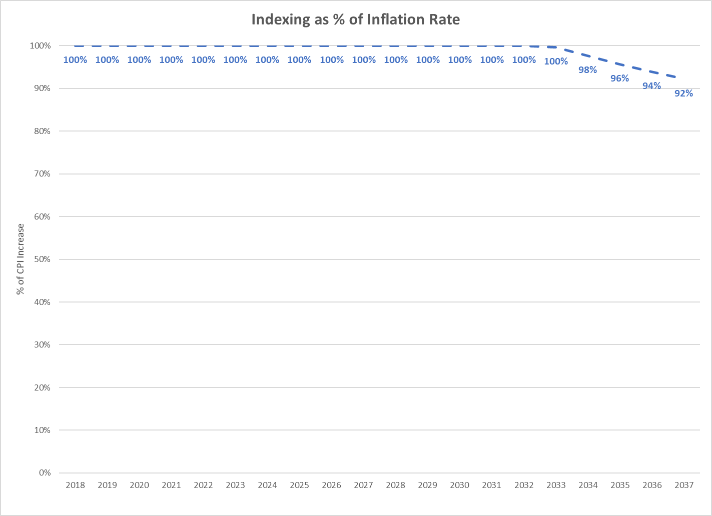
Future Indexing – What Happens if Plan Assumptions Play Out?

Slide 15
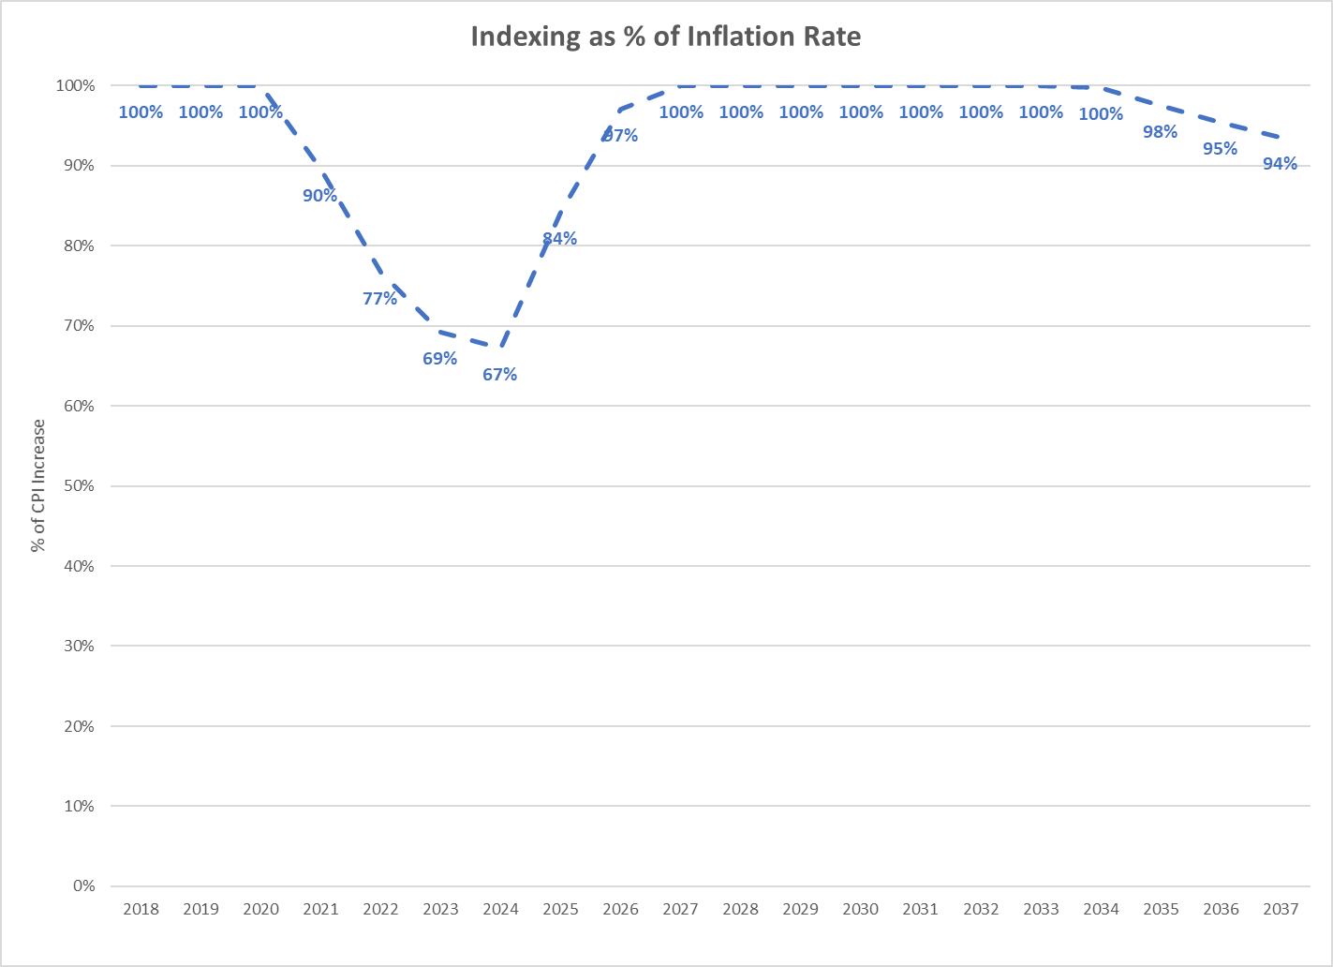
Future Indexing – 15% Drop in the Market Value of Assets?
It is assumed that the drop will be recovered through higher investment returns over the following five years, so that the actuarial assumption of 6.1% per year, on average, is met

Slide 16
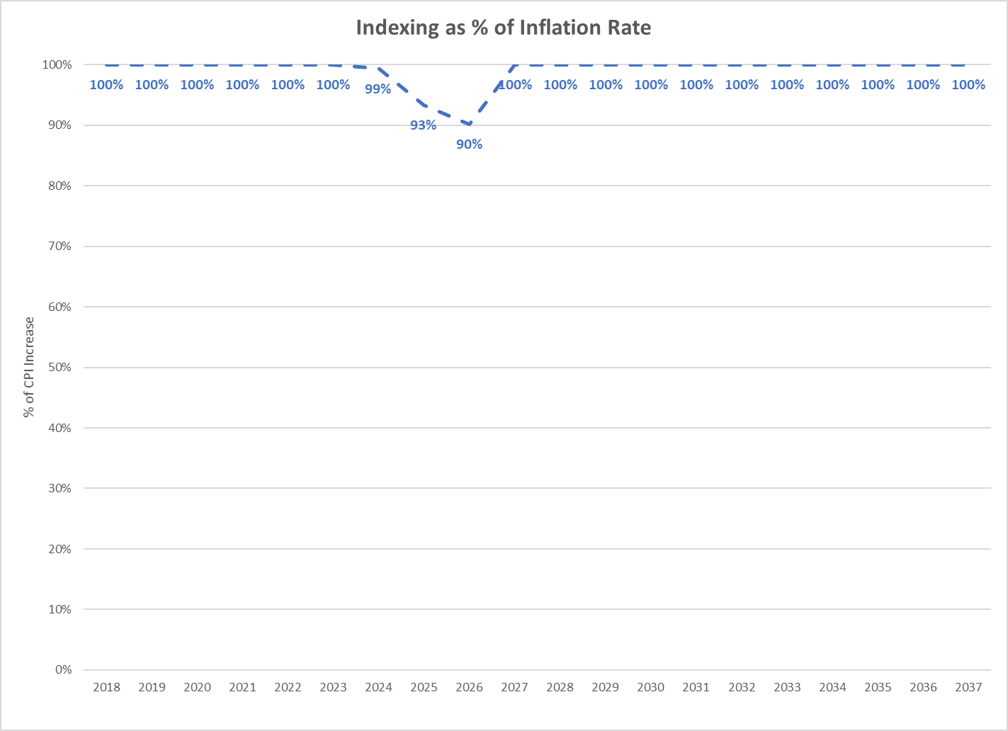
Future Indexing – Two Years of 9% Return, 15% Drop in Year 3?
It is assumed that the drop will be recovered through higher investment returns over the following five years, so that, after the first two years, the actuarial assumption of 6.1% per year, on average, is met

Slide 17
Future Indexing – Average Annual Return Needed for 100% Indexing?
Answer: about 7.0% per annum (6.35% net of expenses).
Reminder – the Plan earned 7.3% per annum on average over the last 10 years, even after factoring in the 2008 downturn.
Reminder – the actuarial assumption is 6.1% per annum, net of expenses.
Therefore, an extra investment return of about 0.25% per annum over the actuarial assumption would be needed to support 100% indexing over the long term.

